Slide 1

Order
Management
Prepared for:
App
Salesforce Training Program
Capgemini Technology Services
Prepared by:
Sourav Bhadra
Notes:
©2016 Capgemini. All rights reserved.
The information contained in this document is proprietary and confidential. For Capgemini only.

Slide 2
Abstract
The Order Management app is a system to keep track of orders and sales for a company. The sales user can add products and create product invoices. The sales user can generate Invoice for the order. The status of the order is updated systematically with order progress. Customer and sales user can also get email alert for every status update of the order if they want. It generates reports for all the sales and top 10 brand which are sold. It has the dashboard to keep track of the reports generated.
Notes:
Add instructor notes here.

Slide 3
Objective
This order management system is crucial in dealing with real time status of order after entry. This system helps in checking the latest update of the order and it also keep track of any fraudulent activity. This system has a capability to improve flow of work and communication with the vendors and customers.
The service industry can have a great boon with this system as they can see the real time sales by the help of reports and dashboards which could be cost effective. In this fast moving world, both B2B and B2C companies are choosing order management system to have a hustle free delivery for their customers.
Notes:
Add instructor notes here.

Slide 4
Technology Used
This project is built on salesforce.com. Customers and companies have become closer with better customer relation management through cloud-based technology. It is an integrated CRM platform, which provides a single view for every customer to all departments, which includes sales, marketing, service, commerce.
Notes:
Add instructor notes here.

Slide 5
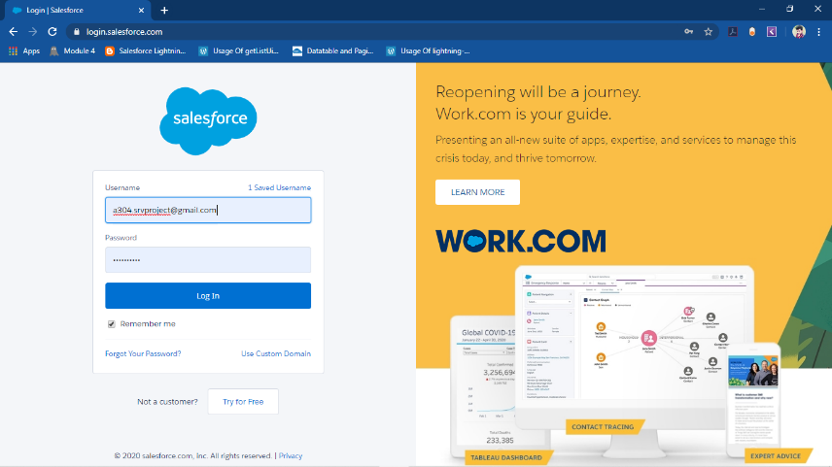
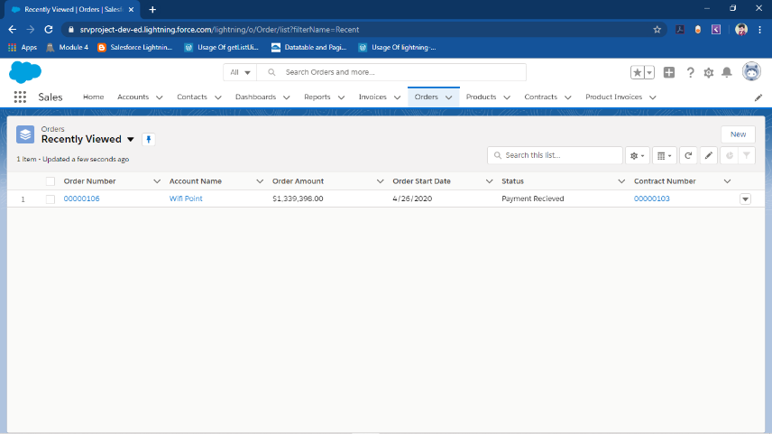
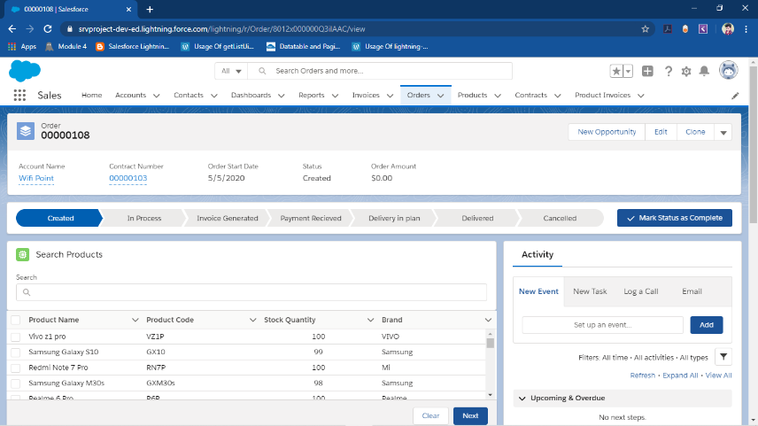
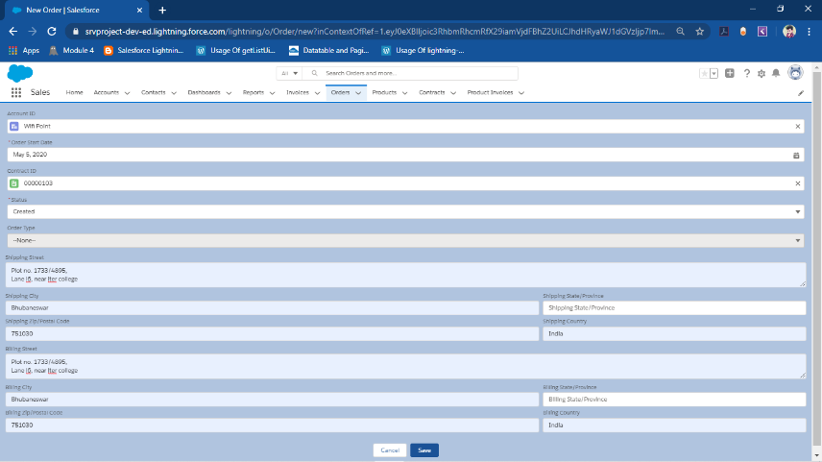
Steps
Notes:
Add instructor notes here.

Slide 6
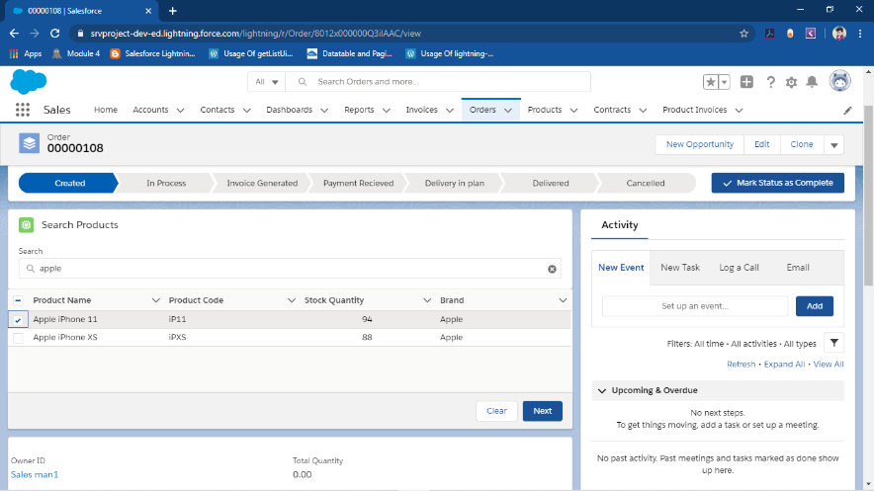
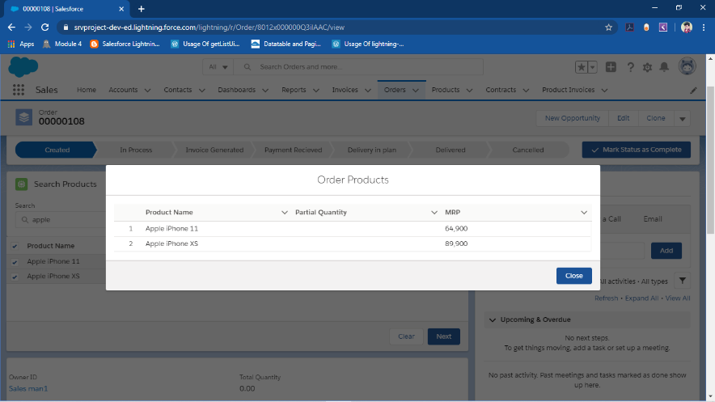
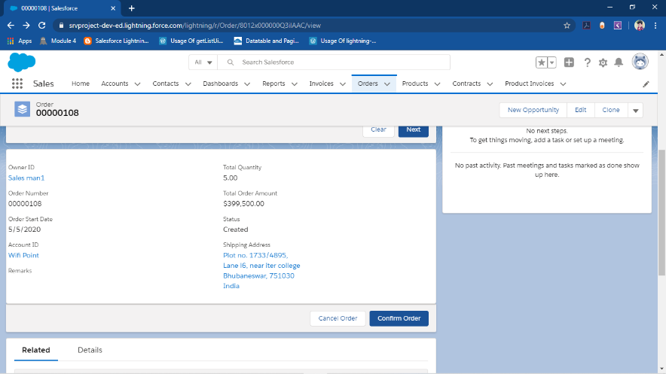
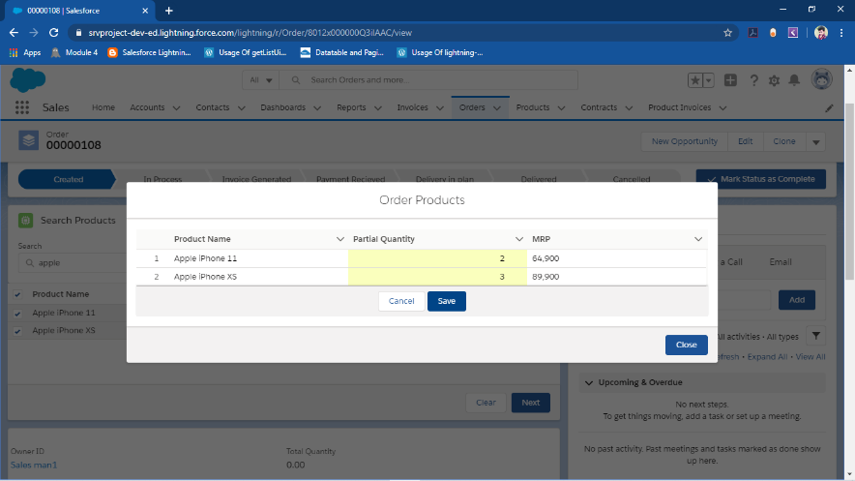
Steps (continued)
Notes:
Add instructor notes here.

Slide 7
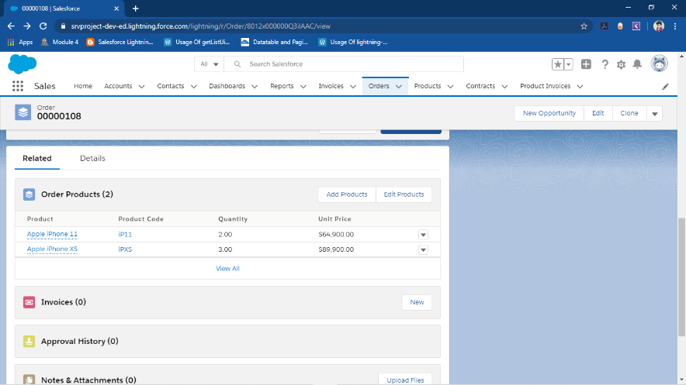
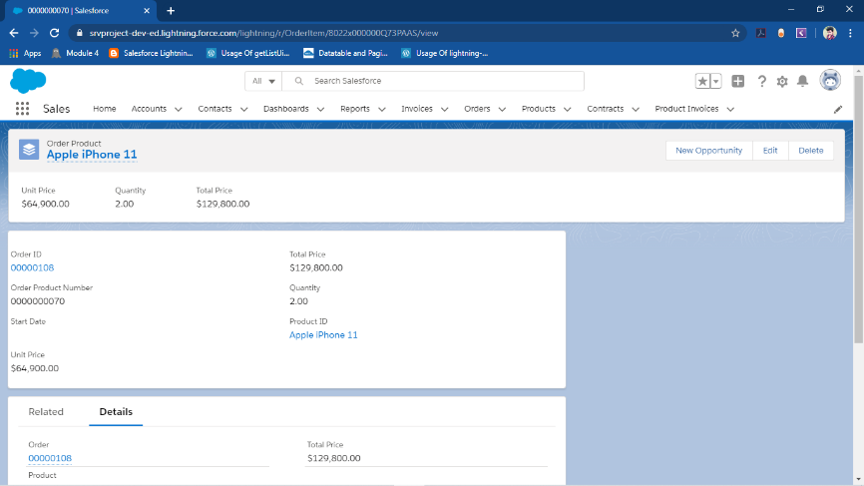
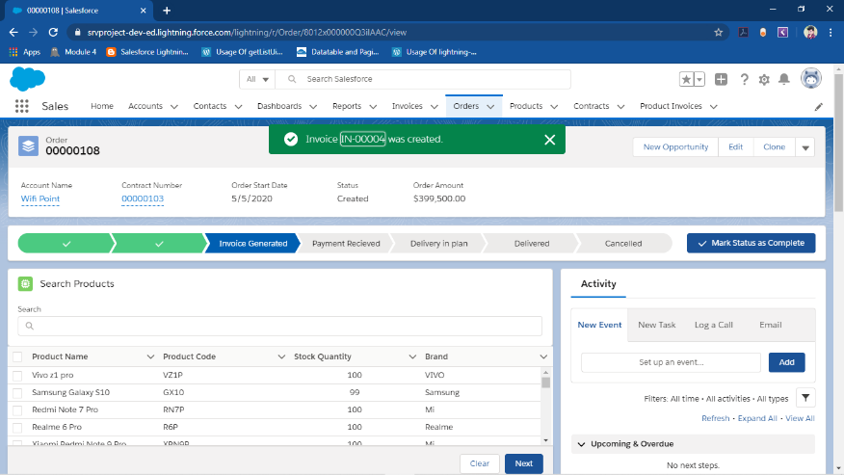
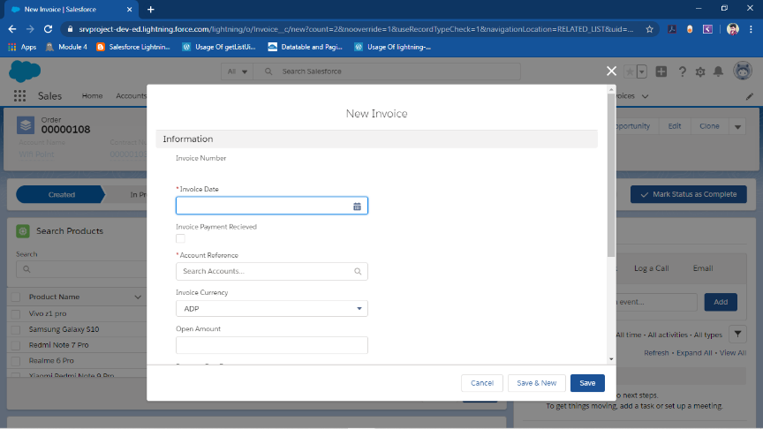
Steps (continued)
Notes:
Add instructor notes here.

Slide 8
Scope
Following is the functionality provided by Order Management App:
There are 3 types of user in this app:
Support User
Business User
Sales User
Notes:
Add instructor notes here.

Slide 9
Scope (Continued)
Support User:
Create business users and sales user
View whole data
Manage Accounts, Contacts and Contracts
Manage Products
View all Orders
Approve or reject orders
Notes:
Add instructor notes here.

Slide 10
Scope (Continued)
Business User:
View 2 sales user data
View Order
View Products
View reports
View dashboards
Notes:
Add instructor notes here.

Slide 11
Scope (Continued)
Sales User:
Create Account
Create contact
Manage Order
Search products
Add products
Confirm/cancel order
Notes:
Add instructor notes here.

Slide 12
Scope (Continued)
Functionalities done in Lightning Web Components (LWC):
  Searching of products in order
  Adding of products to Order Products
  Record view of an order
  Record view of Order Products
  Confirm/Cancel buttons of Order
  Necessary error view
  New and Edit button of Order is overridden with help of Aura.
Notes:
Add instructor notes here.

Slide 13
Out of scope
Only 2 active users can be there in salesforce free license so, approvals are from sales to support users.
The status for delivery is not changed programmatically.
The order delivery doesn’t create any tracking details for the order.
The related list of OrderItem in Order is the default component of the salesforce.
The products in standard Pricebook are shown in search component.
Notes:
Add instructor notes here.

